Slide 1
Qualitative Research V: Projective Techniques

Slide 2
Rationale
Consumers unwilling to reveal true feelings
Consumers unable to reveal true feelings
“Hints” about the brand personality

Slide 3
Projective Task Example: Two Shopping Lists (Haire, 1950)
Pound of hamburger
Loaf of Wonder Bread
Bunch of carrots
Can of baking powder
Can of Maxwell House drip grind coffee
Can of Del Monte pears
5 lbs. of potatoes
Pound of hamburger
Loaf of Wonder Bread
Bunch of carrots
Can of baking powder
Jar of Nescafe Instant Coffee
Can of Del Monte pears
5 lbs. of potatoes

Slide 4
Results
 | Maxwell House | Nescafe
Lazy | 4% | 48%
Fails to plan well for HH purchases | 12% | 48%
Thrift | 16% | 4%
Not a good wife | 0% | 16%

Slide 5
Example: Shopping List Task
Ask respondents to create a shopping list for a typical person who shops at:
Winn Dixie
Kash n’ Karry
Albertson’s
Publix

Slide 6
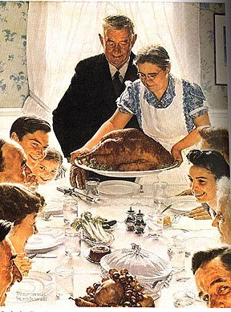
Publix—Any Home USA
Prime Rib, Smoked Salmon, Head of Lettuce, Vitamins, Flowers, Kale, Sushi, Cake, Craft Beers and Wine

Slide 7
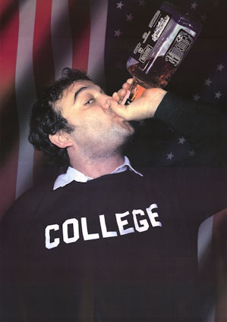
Kash N’ Karry—Jimbo
Cheap Beer, Frozen Pizza,
TV dinners, Oreos,
Chips, Corn Flakes,
Toothpaste and Donuts

Slide 8
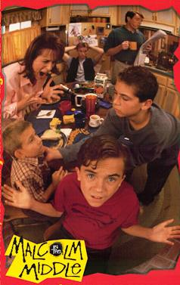
Albertson’s—Malcolm's Mom
Family-Size Package of
Hamburger, 2 Gallons of Milk, Frozen Popsicles, Diapers

Slide 9
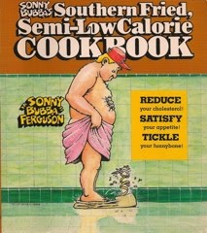
Winn Dixie—Bubba
Bacon, RC Cola, Grits, Pork Chops, Kool-Aid, 2 Cases of Bud Light, Pigs Feet

Slide 10
Other Examples of Projective Questions
If Brand A were a car, what would it be?
  Why that car?
If it were an animal, what kind?
  Why that animal?

Slide 11
Light Beer Projective Task
BUD LIGHT GUY | COORS LIGHT GUY | MILLER LITE GUY
Social guy Easy going, relaxed Loves to party Having fun with friends Loves music Watches sport Loves football Likes fishing | Outdoorsy, rocky type Mountain man Back-to-nature man | Less social person Drunk in the corner at parties Tasteless guy Common, average guy Weaker person
BUD LIGHT ANIMAL | COORS LIGHT GUY | MILLER LITE GUY
Lion Tiger Bear Clydesdales German Rottweiler | Grizzly bear Wolf Horses | Squirrel Raccoon Bird Chihuahua dog
Dog |  | Sloth Turtle Rat Armadillo

Slide 12
Projective Techniques: Pros And Cons
Pros
  Circumvents unwilling/unable to respond
  Adds “richness” to findings
  Discovery of unanticipated ideas
Cons
  Exploratory only
  No evidence of reliability and validity
  Difficult to use for large samples

Slide 13
Conclusion
Do you think your firm could benefit from some projective research into its brand(s)?
Are there important issues confronting your firm that customers may be reluctant to discuss?

Slide 14
End of Lecture

